Slide 1


Project Proposal Presentation
On
AI For Skin Disease Detection
Presented By
AMISHA BASNET (28903/078)
SAISA KOIRALA (28932/078)
SANDESH KHATIWADA (28936/078)
Supervised By
Er. Dhiraj Kumar Jha

Slide 2
Presentation Outline
Introduction
Problem Statement
Objectives
Algorithm Details
Background Study
Literature Review
Conclusion

Slide 3
Introduction
Skin diseases affect millions every year
Early detection is vital for treatment
Manual diagnosis is time-consuming, error-prone
Deep learning helps identify visual patterns
AI improves speed and diagnostic accuracy
We use CNN, DenseNet, MobileNet models
Our aim: assist doctors and patients

Slide 4
Problem Statement
The Problem:
Skin diseases often go undiagnosed early
Manual diagnosis is slow and inconsistent
Misdiagnosis causes delay in treatment
Many rural areas lack dermatologists
Early detection methods need automation

Slide 5
Problem Statement
2. Significance of the Problem:
AI can assist doctors with accuracy
Helps patients in underserved remote regions
Quick detection reduces cost and time
Automating detection ensures wider coverage
Boosts healthcare accessibility and awareness

Slide 6
Problem Statement
2. Scope: Classify 9 skin diseases using images
Use CNN, MobileNet, DenseNet models
Train model with 900 labeled images
Deploy model using Flask-based interface
Allow image upload and prediction output

Slide 7
Objectives
Classify skin disease using deep learning
Use CNN, DenseNet, MobileNet models
Apply transfer learning for better accuracy
Deploy via user-friendly Flask interface
Support diagnosis in low-resource regions

Slide 8
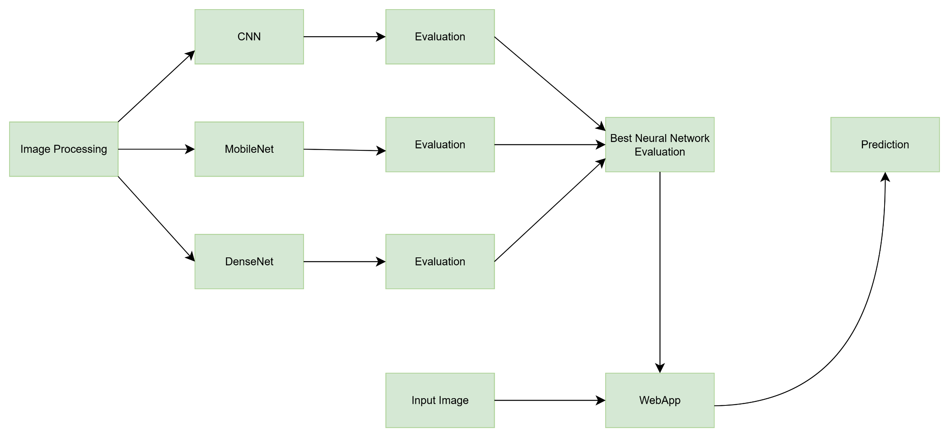
Overview of purposed System

Slide 9
Algorithm Details
Uses CNN, MobileNet, DenseNet pretrained models
Applies image preprocessing: resize and normalize
Extracts features using convolutional layers
Uses Global Average Pooling and dropout layers
Final classification with softmax activation
Trains on labeled skin disease images
Validates accuracy with held-out test set

Slide 10
Algorithm Details
Dataset images resized to 240x240 pixels
Images normalized to improve training stability
Models fine-tuned on medical skin datasets
Uses categorical cross-entropy loss function
Optimized with Adam optimizer for faster learning
Implements dropout to reduce overfitting
Produces probability scores for each skin class

Slide 11
Algorithm Details
Deployment through Flask web interface
Users upload images for instant prediction
System returns predicted disease with confidence
Enables easy access in clinical and remote areas
Designed for real-time skin disease detection
Supports early diagnosis and treatment decision
Helps dermatologists by automating image analysis

Slide 12
Background Study
AI: used widely in healthcare diagnostics
CNNs extract spatial features from images
Transfer learning saves training resources
DenseNet connects layers for efficient flow
MobileNet: designed for mobile devices
Python, Keras used for model creation
Flask used for web-based predictions

Slide 13
Literature Review
Many studies explored skin disease classification
CNNs replaced handcrafted features and SVMs
Lesion Feature Network improved segmentation accuracy
Deep CNNs used Jaccard loss function
Lightweight CNNs reduced model parameters effectively
Our model builds on these advancements

Slide 14
Conclusion
Build a working AI detection system
Classify 9 skin diseases from images
Use CNN, DenseNet, MobileNet models
Train and test on kaggle dataset
Help doctors in early disease detection
Flask-based interface for easy use
Future goal: improve data, deploy mobile

Slide 15
Thank you

